Slide 1
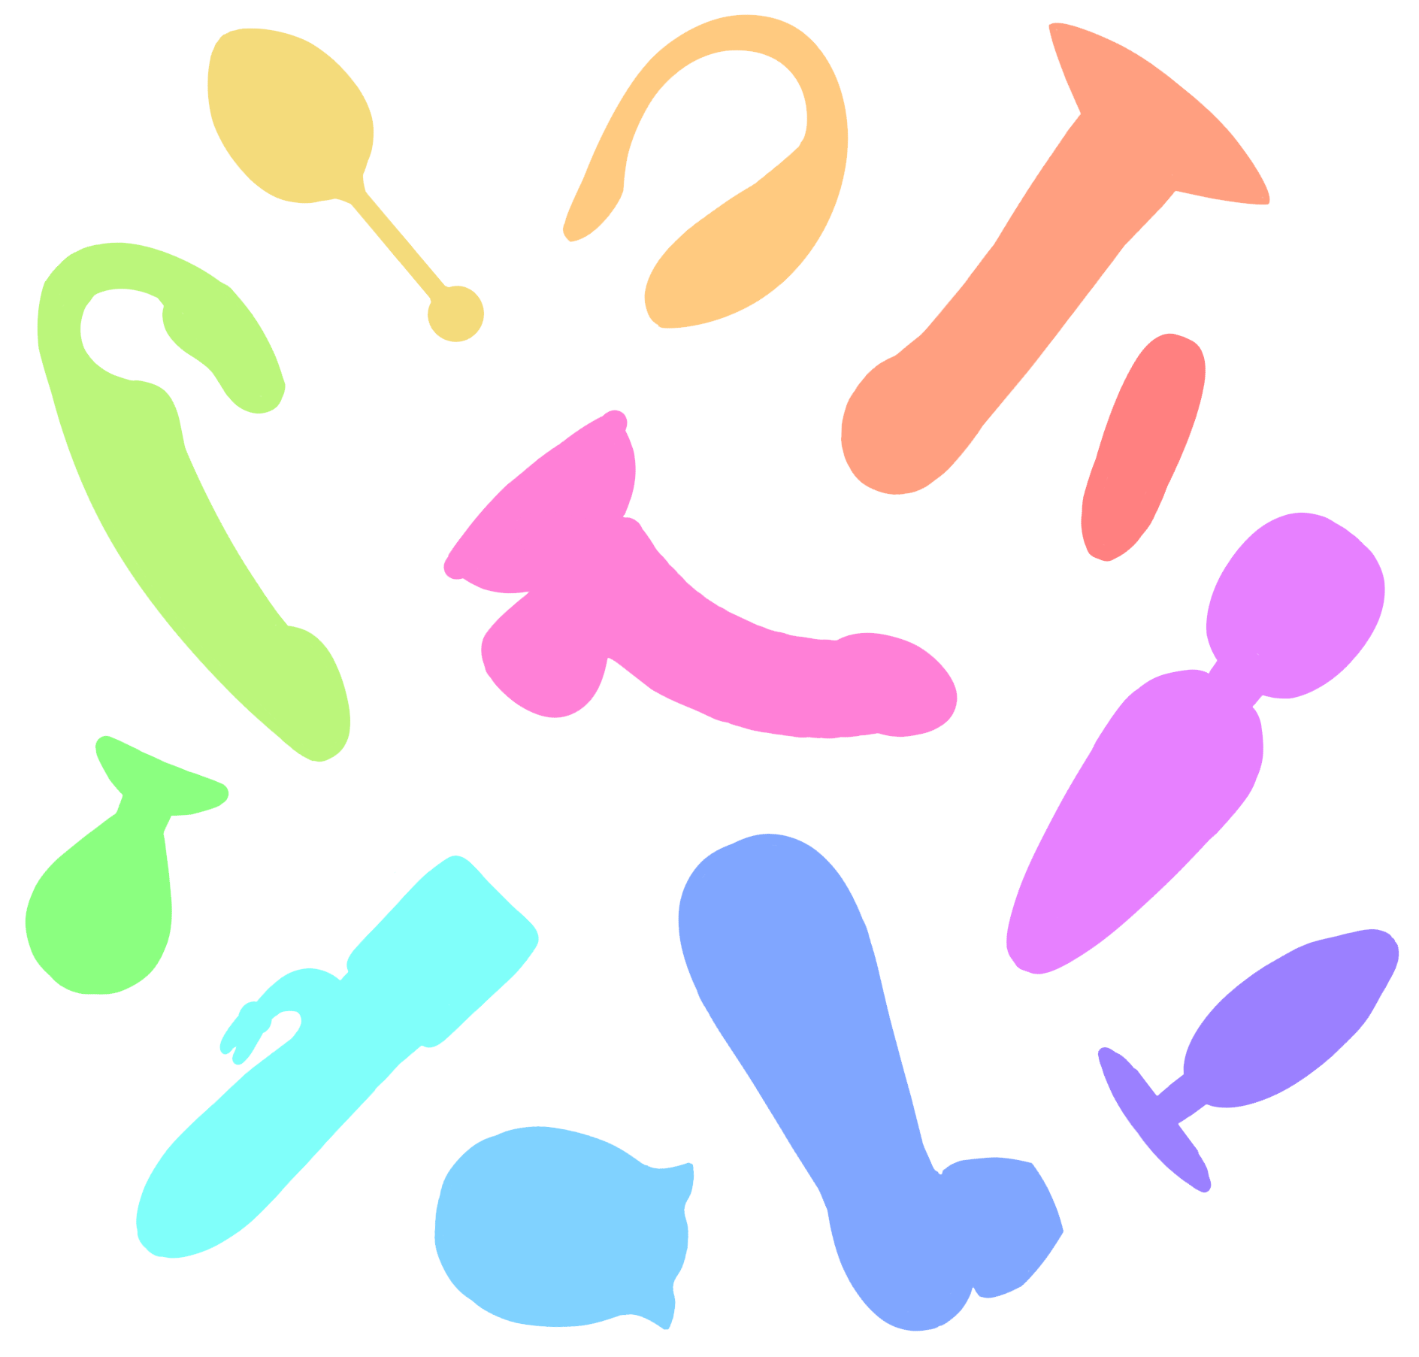
LET’S TALK TOYS
START
JEOPARDY!
Created by Aster Wallace
SOURCES

Slide 2

Materials
Vibrators
Cleaning
Assorted
$200
$200
$200
$200
$400
$400
$400
$400
$600
$600
$600
$600
$800
$800
$800
$800
$1000
$1000
$1000
$1000

Slide 3
Materials $200
This is the gold standard material for sex toys.
What is medical-grade silicone?
BACK

Slide 4
Materials $400
A plastic material that is used in sex toys and Legos.
What is hard ABS plastic?
BACK

Slide 5
Materials $600
This is the only metal that sex toys should be made of.
What is medical-grade stainless steel?
BACK

Slide 6
Materials $800
This is a type of glass that is used in sex toys and cookware.
What is borosilicate glass?
BACK

Slide 7
Materials $1000
This word is used to describe materials that are non-porous, phthalate-free, non-toxic, and hypoallergenic.
What is body safe materials?
BACK

Slide 8
Vibrators $200
This type of sex toy was invented and popularized during the twentieth century and is often used to stimulate the clitoris.
What is suction/air pulse toy?
BACK

Slide 9
Vibrators $400
These types of vibrators are known for their rumbly vibrations that can stimulate nerves deeply.
What is wand, rabbit, or dildo vibrator?
BACK

Slide 10
Vibrators $600
This type of vibrator is known for its targeted buzzy vibration that can be described as intense.
What is bullet or egg vibe?
BACK

Slide 11
Vibrators $800
This company manufactures tanks, excavators, and wand vibrators.
What is Hitachi?
BACK

Slide 12
Vibrators $1000
This doctor invented the precursor to the vibrator (they were originally used to treat pain, deafness, and spinal disease) in the early 1800s.
Who is Joseph Mortimer Granvile?
BACK

Slide 13
Cleaning $200
This common household substance can be used to clean sex toys if paired with warm water and scrubbing for 30 seconds.
What is a mild unscented, antibacterial soap?
(sex toy cleaning wipes or spray can also be used).
BACK

Slide 14
Cleaning $400
This methods are often used to sanitize toys that don't have a motor/vibrator.
What is boiling or running through the dishwasher?
BACK

Slide 15
Cleaning $600
This is how often you should clean your sex toys for the least chance of infection or skin irritation.
What is before and after use?
(If a toy is being used between partners, or anally and vaginally clean and sanitize
the toy between uses, additionally make sure to store toys not touching
In place that they can breathe).
BACK

Slide 16
Cleaning $800
This micro-porous material can hold onto scents from lubes or body fluids but still be free of bacteria.
What is medical-grade silicone?
(this is because scent particles are 50 times smaller than bacteria).
BACK

Slide 17
Cleaning $1000
These substances together can be used to remove stubborn scents from sex toys.
What is baking soda and isopropyl alcohol?
BACK

Slide 18
Assorted $200
This is the part of the body that can be stimulated by a butt plug within an AMAB individual’s body.
What is the prostate?
(Butt plugs can also be pleasurable for AFAB individuals as it can stimulate the internal structure of the clitoris and increase tightness of the vaginal canal).
BACK

Slide 19
Assorted $400
This type of lube can't be used with silicone toys but is great for anal use due to its stay power.
What is silicone-based lube?
(Water-based lubes can be used with silicone toys).
BACK

Slide 20
Assorted $600
This type of lube can be used in a pinch but is not recommended for frequent use as it can irritate skin and can erode condoms or dental dams.
What is oil-based lube or petroleum-based products?
BACK

Slide 21
Assorted $800
This object was found in Germany in 2005 and is estimated to be about 28,000 years old.
What is a siltstone dildo?
BACK

Slide 22
Assorted $1000
This is the form of measurement used to indicate the hardness of a sex toy.
What is shore hardness scale?
BACK

Slide 23
Sources
Adcox, M. (2023, April 25). Your guide to lube for SEX: Types, how to use, and more. Healthline. https://www.healthline.com/health/healthy-sex/lube-shopping-guide-types
daisies. (2024, March 22). The History of Suction Vibrators - ForPlay Toys. ForPlay Toys. https://forplaytoystore.com/the-history-of-suction-vibrators/
Dodil, T. (2018, April 28). Dildo-envy? the average dildo size compared to the average penis. Medium. https://medium.com/@thedodil/dildo-envy-the-average-dildo-size-compared-to-the-average-penis-da45ec24ba93
Dragon, B. (2025). Firmness 101: A Guide to Firmness Options. Bad-Dragon.com. https://bad-dragon.com/pages/firmness-guide
Felicity, T. (2025, January 22). Anal plug cleaning: How to remove Butt plug odor. Phallophile Reviews. https://phallophilereviews.com/how-to-clean-butt-plug-odor/
Haines, L. (2005, July 27). Germans discover world’s oldest dildo. Theregister.com; The Register. https://www.theregister.com/2005/07/27/ancient_phallus/
Kerr, J. (2024, April 19). How to store sex toys. Mashable. https://mashable.com/article/how-to-store-sex-toys
Lawless, L. (2020, July 20). Sex toy materials. Holistic Wisdom. https://www.holisticwisdom.com/blogs/sex-toy-guide/sex-toy-materials
Lieberman, H. (2020, January 3). (Almost) Everything You Know About the Invention of the Vibrator Is Wrong. Ivan Allen College of Liberal Arts. https://iac.gatech.edu/news/item/631497/know-invention-vibrator-wrong
Quispe López. (2024, September 19). The Magic Wand Vibrator Company Hitachi Also Makes Tanks. Them; Them. https://www.them.us/story/magic-wand-vibrator-fun-facts
Santos-Longhurst, A. (2021, March 15). How to Correctly Clean and Store Your Sex Toys. Healthline; Healthline. https://www.healthline.com/health/healthy-sex/how-to-clean-sex-toys
Scott, R. (2022, November 23). Good vibrations - the difference between Rumbly and buzzy vibrators. Love Not War. https://www.l-n-w.com/blogs/love-not-war-blog/good-vibrations-the-difference-between-rumbly-and-buzzy-vibrators?srsltid=AfmBOor5ZjTkNHRJfqgdSw5TBmGSuHgJfIhkdy4ZEsBJsNSyyZuKbWkB
TNLC, T. (2024, December 6). The Comprehensive Guide to non-toxic sex toys. The Natural Love Company. https://www.thenaturallovecompany.com/the-comprehensive-guide-to-non-toxic-sex-toys/
BACK

